Slide 1
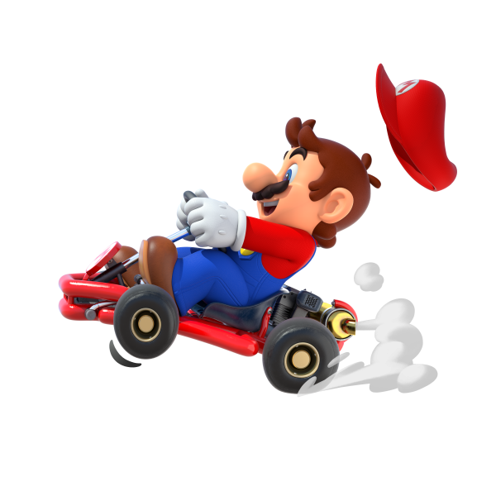
Here WeGo!
Nashville’s Public Transit Connecting Local & Regional Bus Routes
Starring Isabelle Pethtel, Jacob Jarrell, and Tarik Kalwar

Slide 2
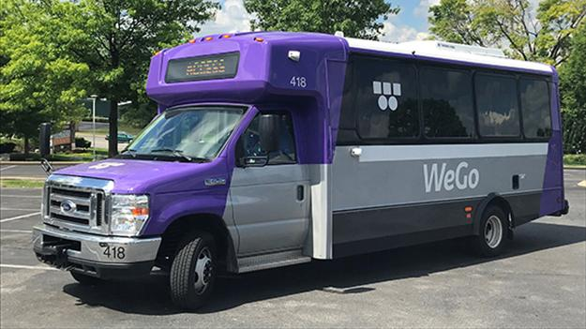
Where Did We Come From, Where do WeGo?
Metropolitan Transit Authority originally established in 1973.
In 2018, the MTA officially rebranded as WeGo Public Transit.
Serves Nashville & Davidson County with smaller, nearby communities incorporated over time.
Wego’s vision is “To become an embraced part of the community through friendly, sustainable, reliable, trusted public transportation - everywhere for everyone.”
Most recently, as of March 2025, WeGo partnered with Tennessee Department of Transportation (TDOT) to implement TDOT Choice Lanes allowing passengers to ride these lanes for free.

Slide 3
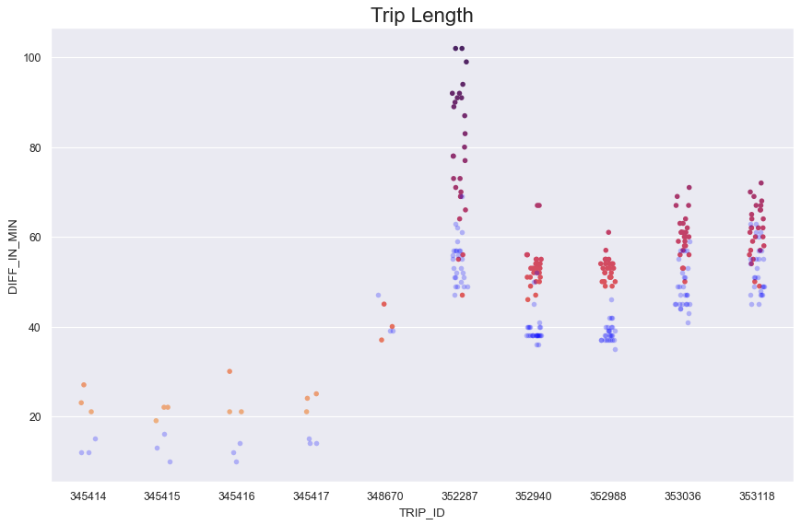
Most Run & Least Run Trip Times

Slide 4
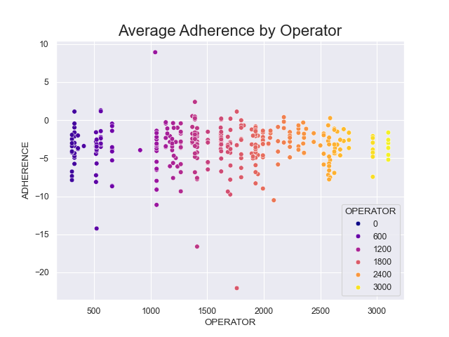
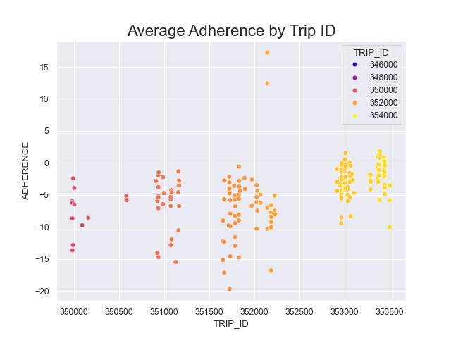
Comparing Impact Factors of Adherence

Slide 5
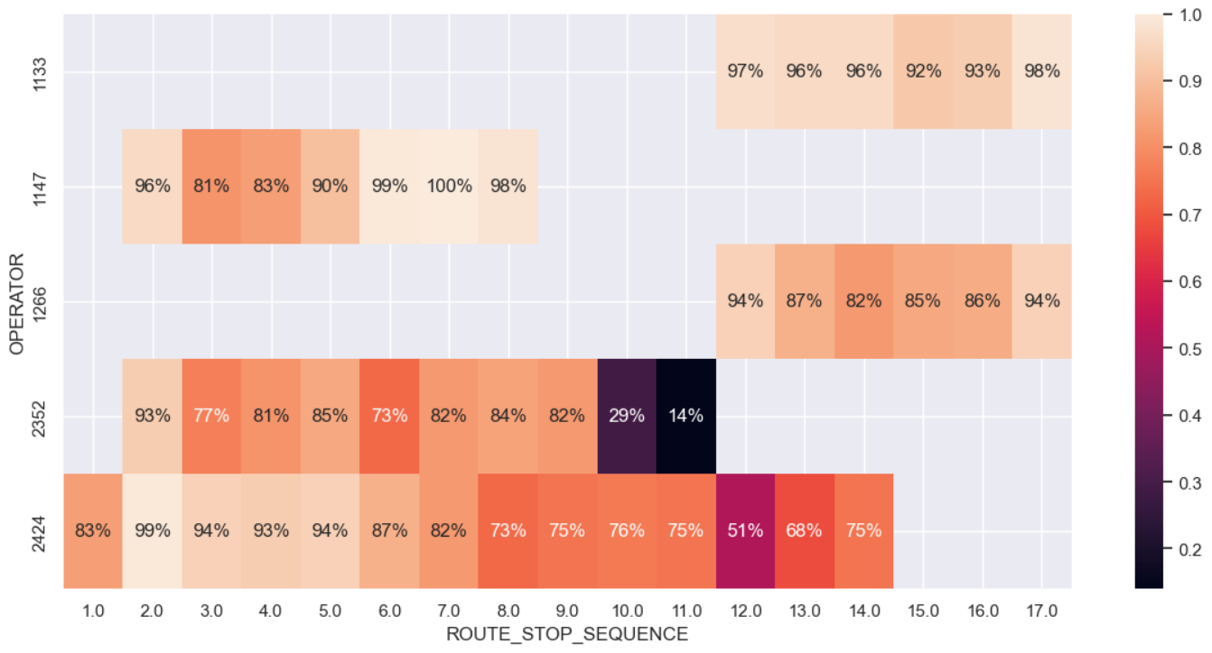
On-time Percentage Per Operator Per Stop
Notes:
We proceeded with our analysis by looking into how some of the best WeGo drivers were performing. Filtering for the top 5 out of the 341 Operators with the most experience we were able to piece together a heat map giving us the highlights of their time behind the wheel. We compared the operator to the route stop sequence, which is essentially the list of stops within their routes. We see some operators having more values than others indicating their route is either more complicated or they actually drive more than one route. And as you can see both operators 1133 and 1266 run the exact same route. And while the first three operators performed very well we see operators 2352 and 2424 ran larger sequences but with more difficulty.
RETRO:
However, that experience doesn’t always translate to high marks. Note Daisy and Yoshi.
Bear in mind that Daisy and Yoshi run more routes. Mario is statistically more accurate at his stops.
Peach runs the same Route as Mario but doesn’t do as well even though she’s run the same route almost 300 more times.
Question? Does time of day play a factor in the difference between Mario and Peach?

Slide 6

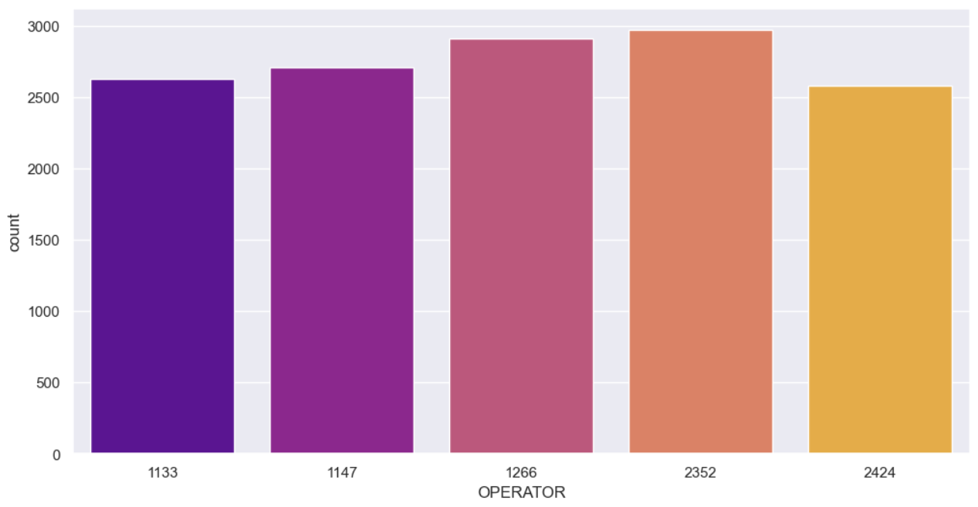


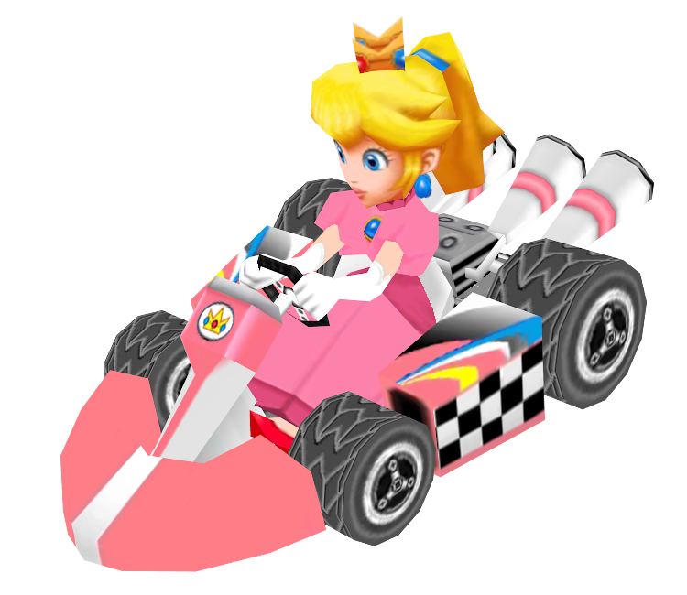
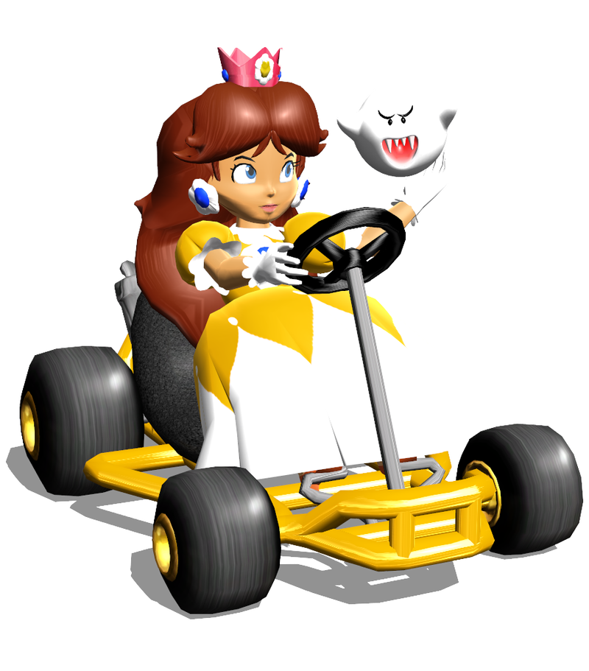

Gateway to Experiment
Most Experienced Operators!
Notes:
Once we had a grasp on how well these operators performed we looked at exactly how many times they drove their routes.
Essentially we looked at who had the most overall experience. Experience was derived from how many times the individual operators ran their routes. It is interesting to note that operator 2352 who had some issues of note from the previous slide actually ran nearly 3000 times.
So, using this knowledge we decided to run an experiment. We turned our Operators into Racers – “Testing their skills”. We wanted to see how’d they’d do on diff routes…keep in mind it’s about skill not speed!
Allow me to introduce our riders: Mario, Luigi, Peach, Daisy, and Yoshi!

Slide 7


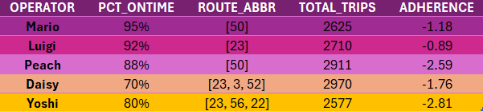
Player Overview
Notes:
Let’s give everyone a good idea of who our players are! Notice the Percent On-time to total trips and the fact that even if you only have one route it doesn’t necessarily mean you’ll have a better adherence level. Daisy and Yoshi for instance ran actually ran 3 different routes. Daisy, with all those runs still had a better adherence level than Peach and Yoshi!

Slide 8
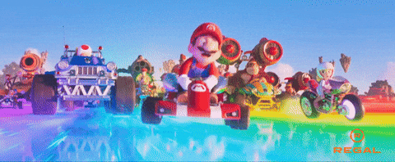
Now WeGo… To The Map!

Slide 9


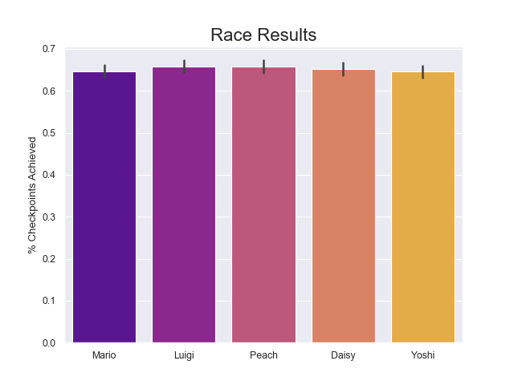
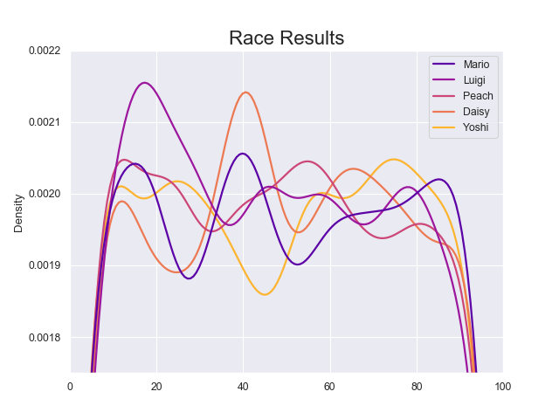
Race Results

Slide 10
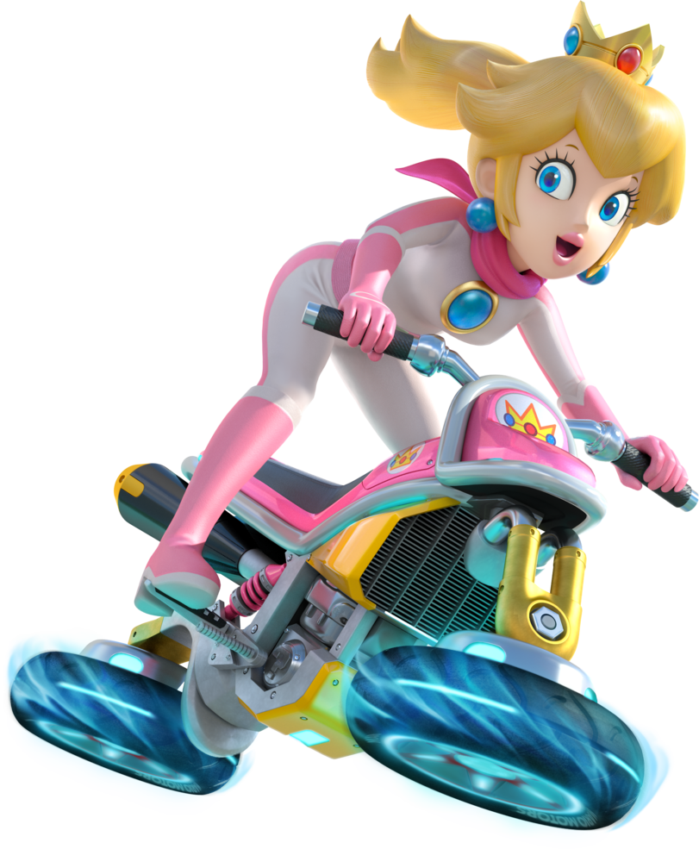

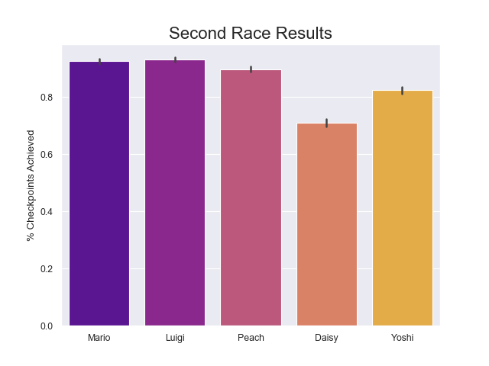
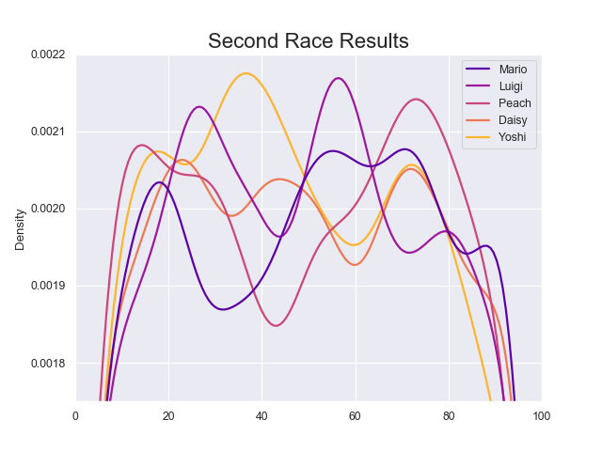
Second Race

Slide 11
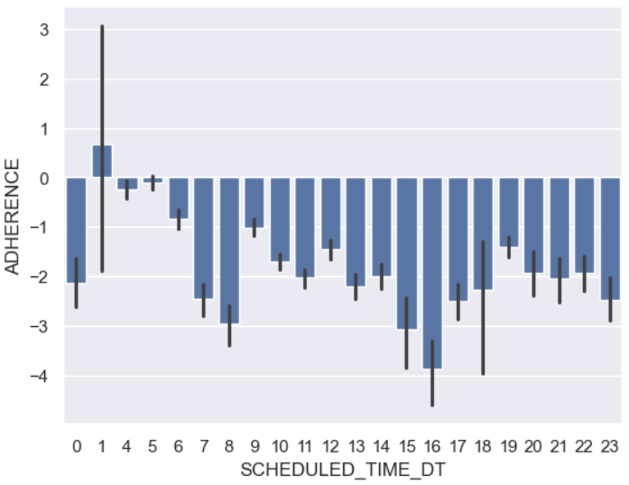
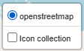
Retro
Race outcomes & probability
Include other variables to skew predictability & probability
Player experience & outlier values - Daisy’s experience vs Mario’s shorter route
General Analysis
Look further into time of day & performance to see if certain hours do better/worse than average
Folium’s LayerControl
Morning, Afternoon, Evening
Route complexity & ‘difficult’ stops
Continued dive into Sequence Numbers & presence on map
Notes:
If we had more time we could have figured out how fast the individual drivers were going by using the time-stamp combined with lat/long to figure out route issues like rush hour.
IF Daisy had not messed up on route stops 10 and 11(slide 7) she could have potentially been a great driver. She drives 3 different routes, has the most overall trips, and still has a strong adherence of -1.76 (slide 8). Experience does not necessarily result in the best driver.

Slide 12

Credits
https://en.wikipedia.org/wiki/WeGo_Public_Transit
https://www.wegotransit.com/

Slide 13

Outro

